Slide 1
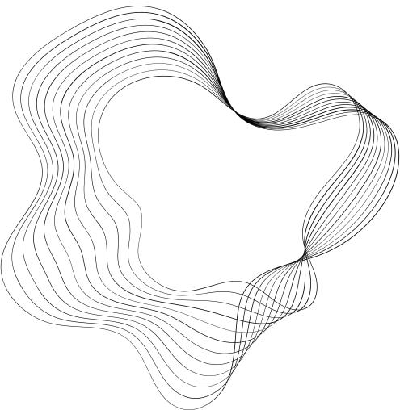
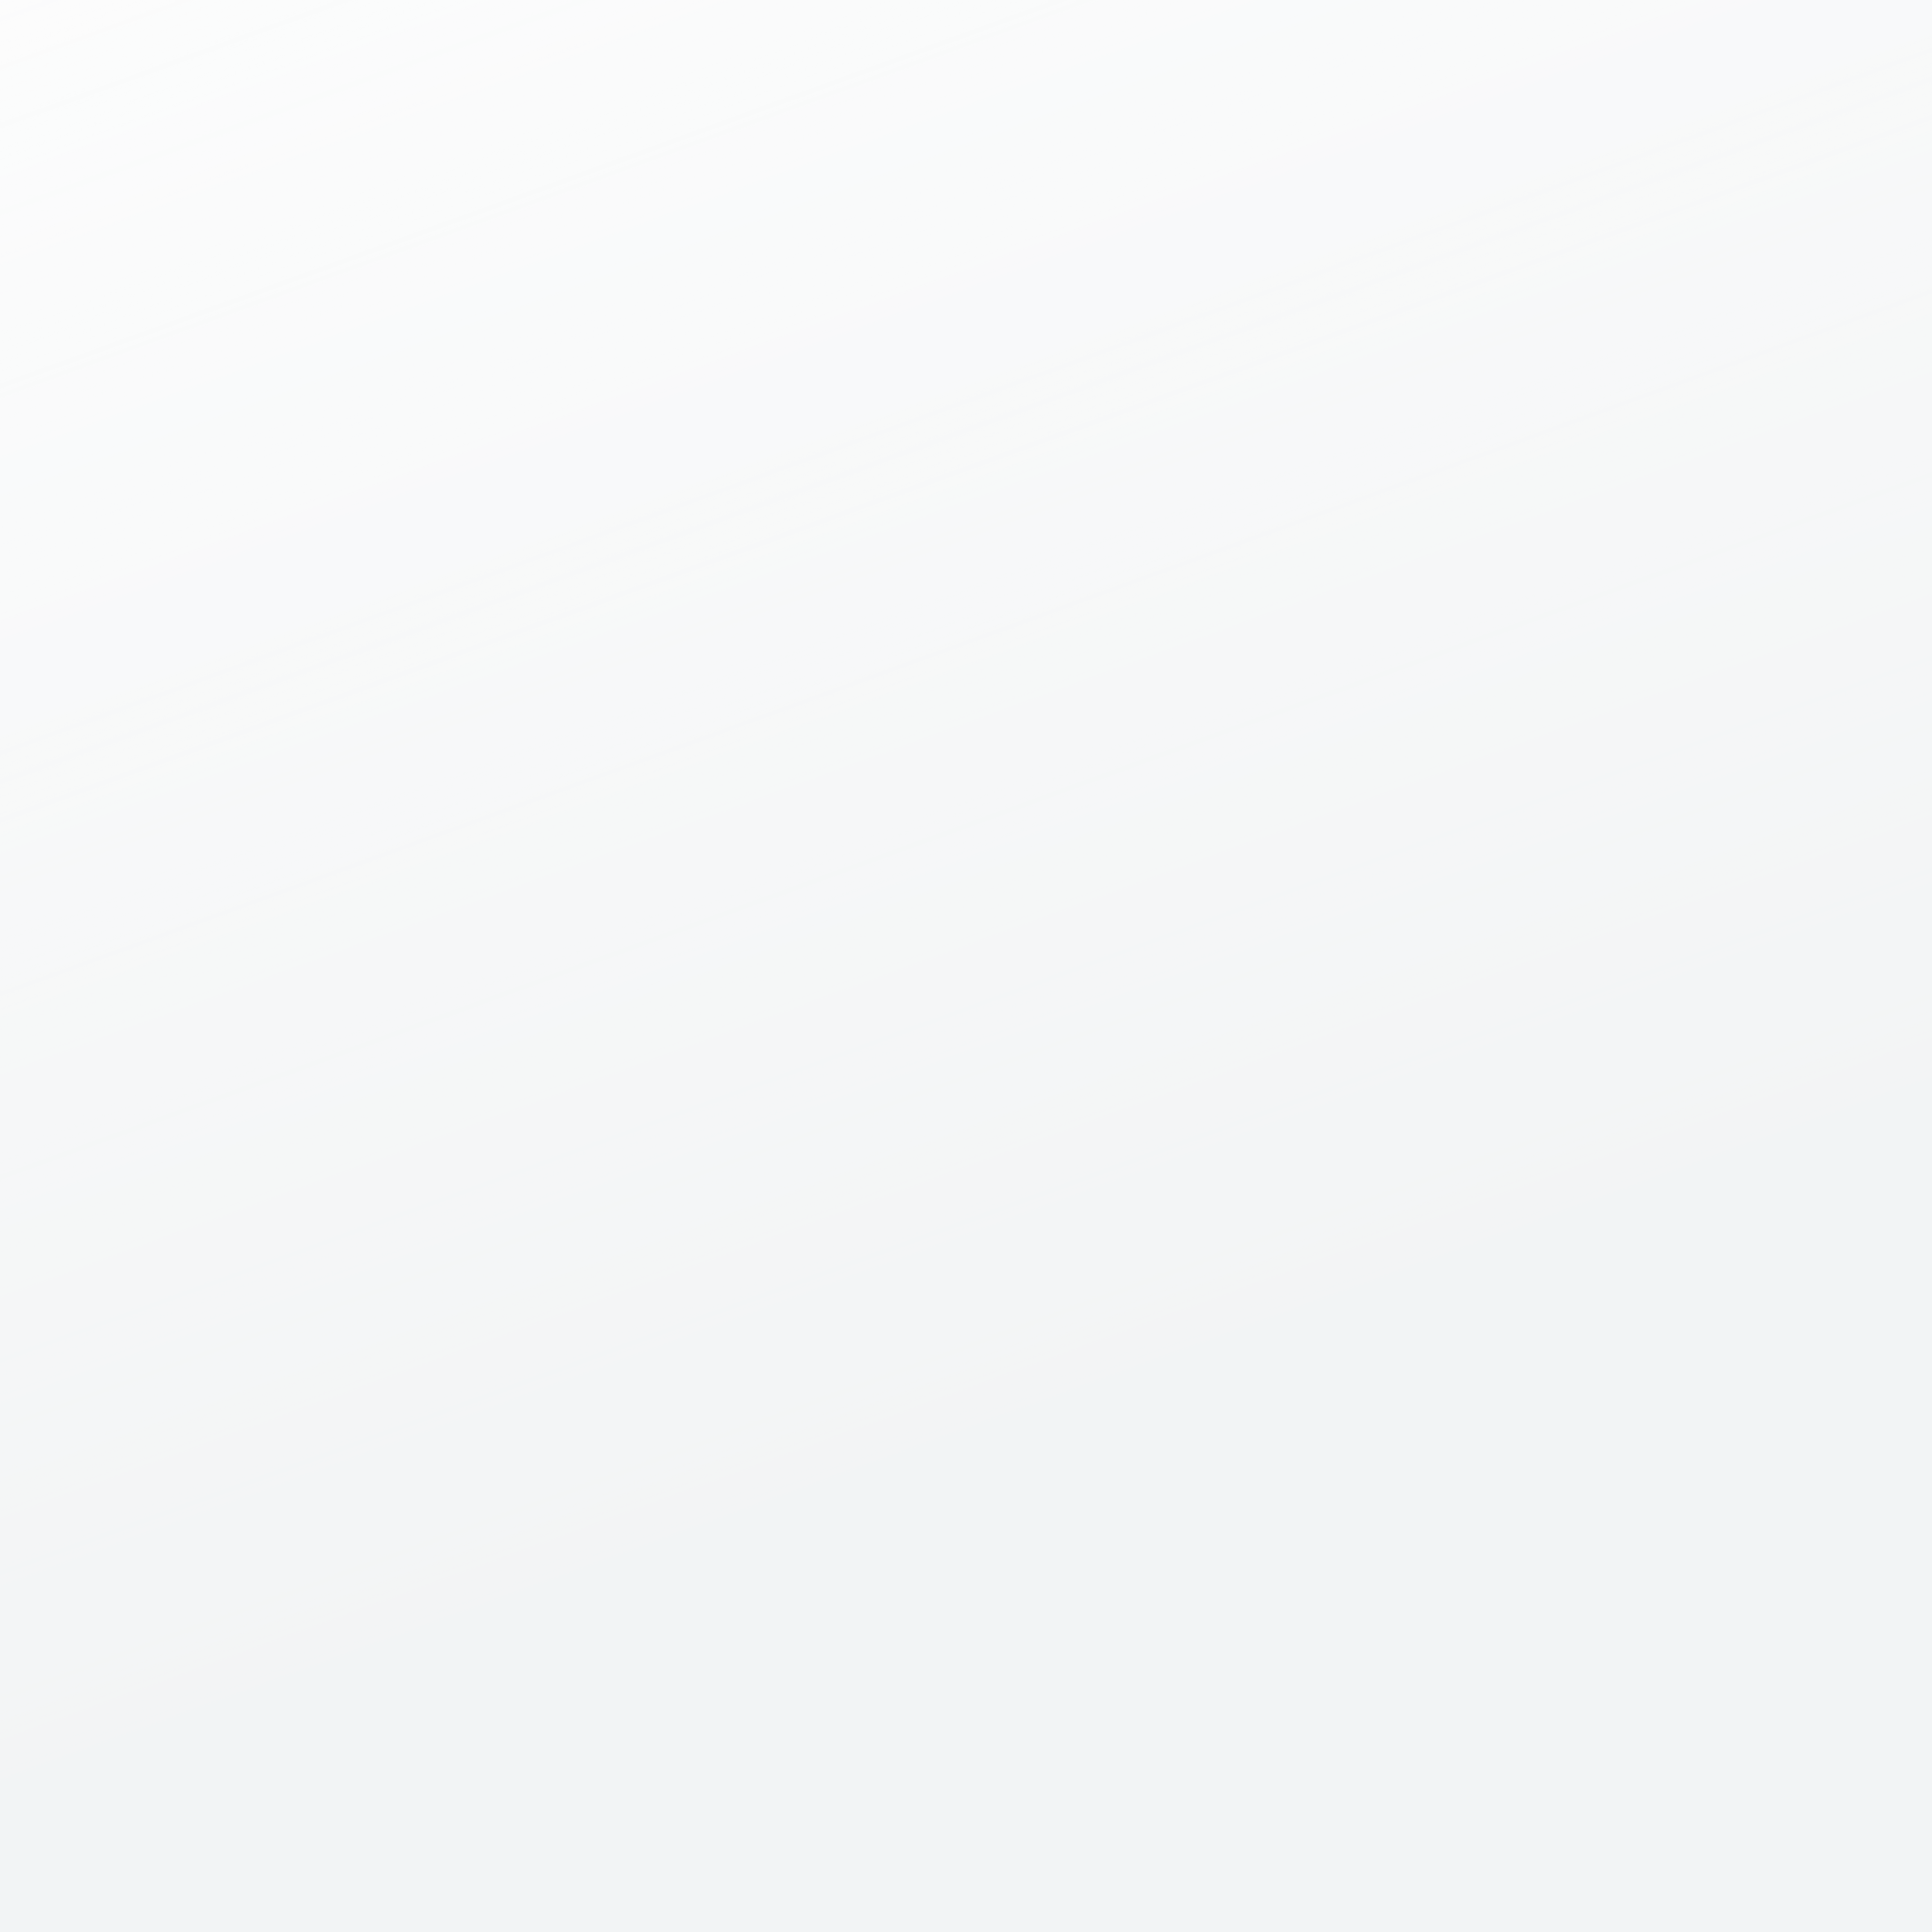
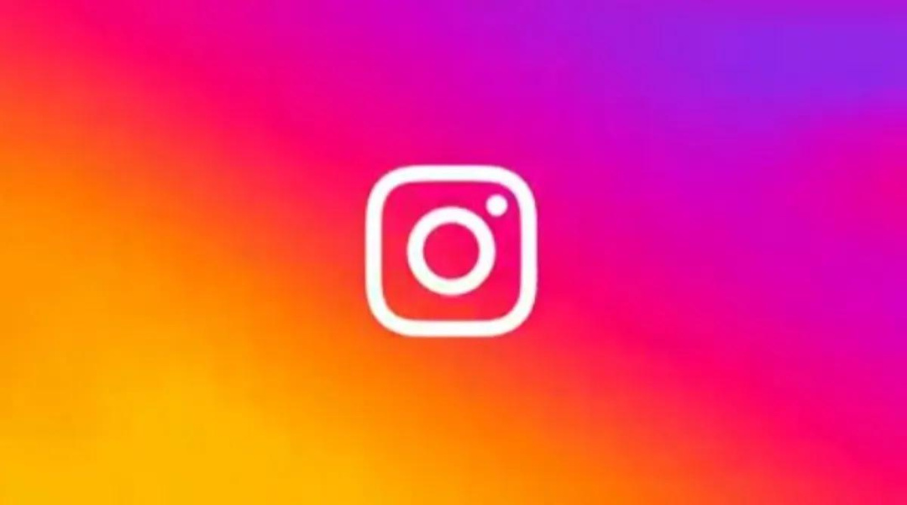
INSTAGRAM
USER ANALYSIS
USING SQL

Slide 2

CONTENT
01
Project Description
02
Approach
03
Tech-stack Used
04
Insight
05
Reasult

Slide 3
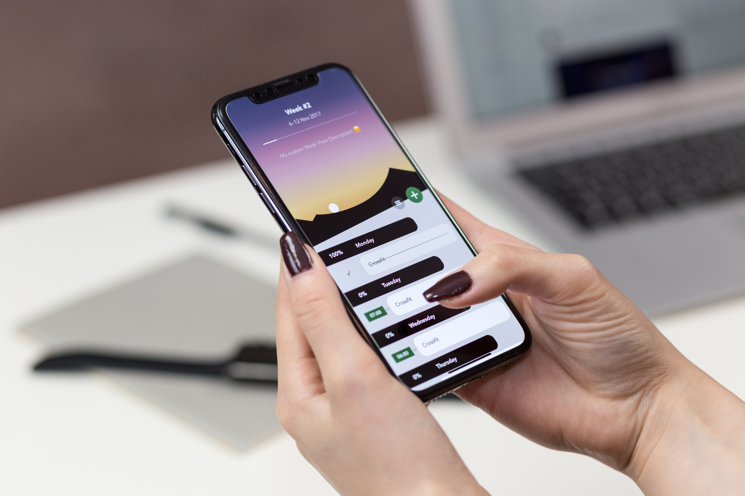


PROJECT DESCRIPTION:
Finding business insights that can be used by teams across the business to launch a new marketing campaign, decide on features to build for an app, track the success of the app by measuring user engagement and improve he experience altogether while helping the business grow.

Slide 4


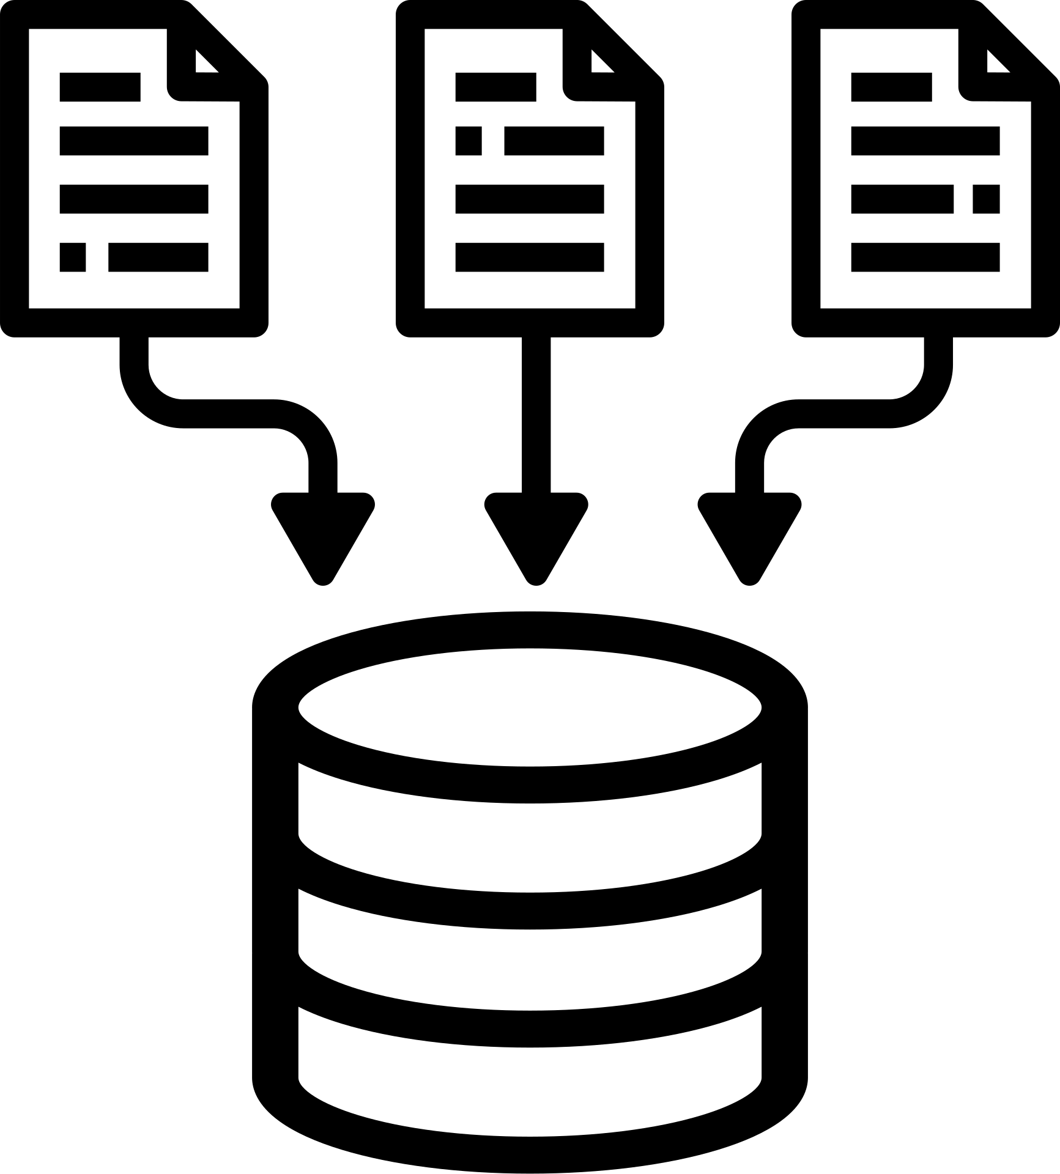
APPROACH
Database creating
Extracting of insights
Create and inserted the values in the database using the DDL and DML SQL queries provieded by the product manager(as per project) in the MySQL database using MySQL workbench
After creating the database required insights are generated from the database tables by running SQL queries in MySQL workbench

Slide 5

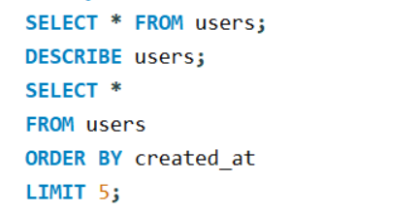
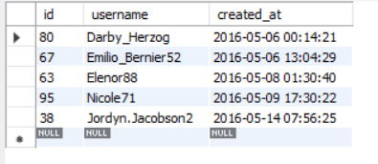
INSIGHTS: MARKETING
Rewarding Most Loyal Users: People who have been using platform for the longest time.
The 5 Most oldest users of the Instagram from the database are:
Result

Slide 6
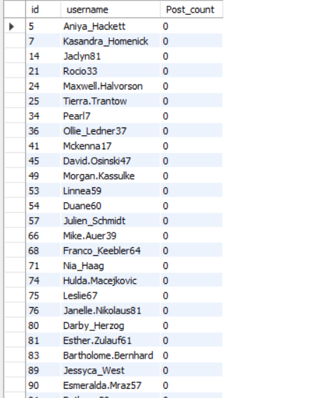
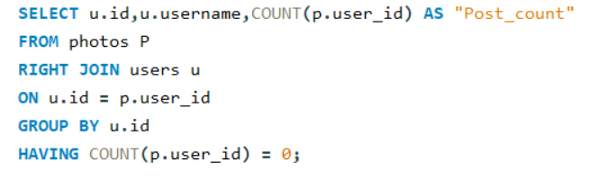
INSIGHTS: MARKETING
Result
2.Remind Inactive Users to Start posting: By sending them promotional email to post their 1st Post.

Slide 7
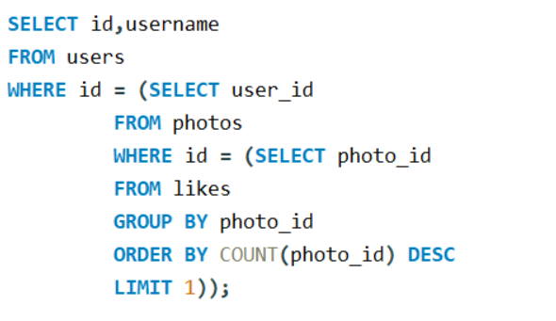

INSIGHTS: MARKETING
3.Declaring Contest Winner: The team started a contest and the user who gets the most likes on a single photo will win the contest now they wish to declare the winner.
Result

Slide 8
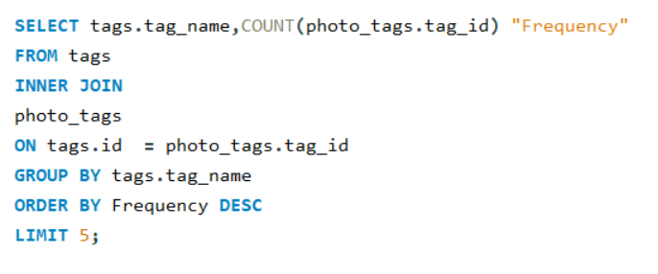
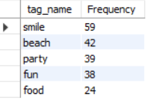
INSIGHTS: MARKETING
4.Hashtag Researching: A partner brand wants to know, which hashtags to use in the post to reach the most people on the platform.
Result

Slide 9
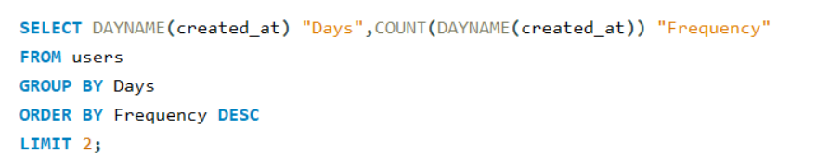

INSIGHTS: MARKETING
5.Launch AD Campaign: The team wants to know, which day would be the best day to launch ADs.
Result

Slide 10
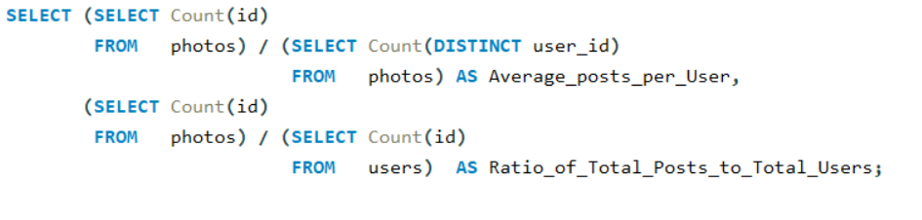

INSIGHTS: INVEST METRICS
6.User Engagement: Are users still active and post on Instagram or they are making fewer posts.
Result

Slide 11
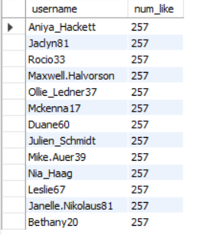
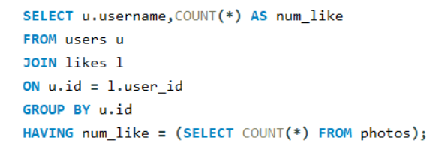

INSIGHTS: INVESTOR METRICS
7.Bots and Fack Accounts: The investors want to know if the platform is crowded with fack and dummy accounts .
Result

Slide 12



RESULT
Conclusions from above analysis:
marketing team can reward the most loyal customers, send promotional emails to inactive user, use popular hashtags and most active day for brand promotion
Use engagement can be very useful growth success matric for the company
Company can remove the bots and fake accounts from the platform to enhance the user experience.
CUSTOMERS

Slide 13

THANK YOU

